Slide 1
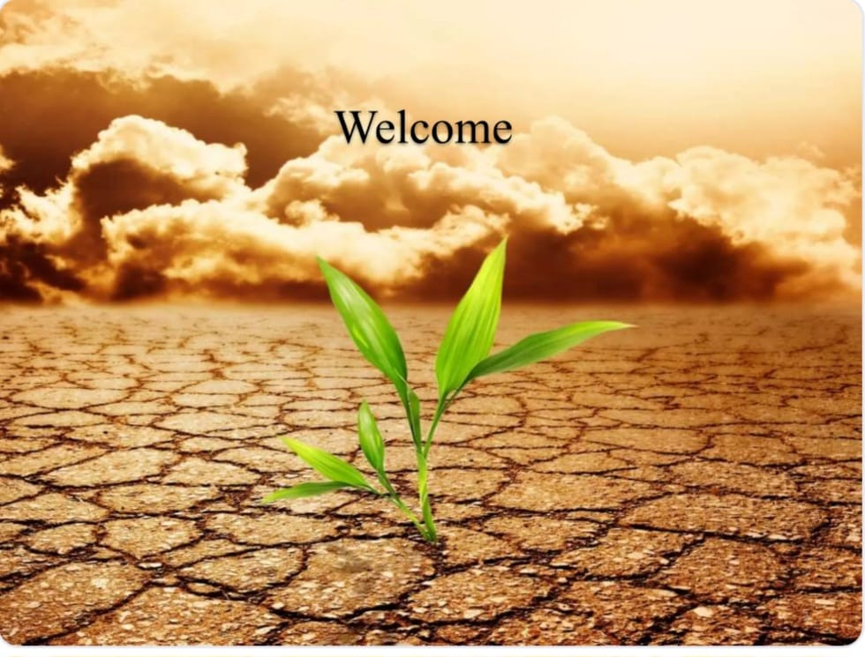
🌍 Climate Change Impact on Agriculture 🌱
By : Chalana.S
Sushmita.S

Slide 2
INTRODUCTION
Climate change has a profound impact on global agriculture, affecting crop yields, soil health, and farming sustainability. This synthetic dataset is designed to simulate real-world agricultural data, enabling researchers, data scientists, and policymakers to explore how climate variations influence food production across different regions.
🔍 Key Features: ✔️ Climate Variables – Simulated data on temperature changes, precipitation levels, and extreme weather events ✔️ Crop Productivity – Modeled impact of climate shifts on yields of key crops like wheat, rice, and corn ✔️ Regional Insights – Includes various geographic regions to analyze diverse climate-agriculture interactions ✔️ Ideal for Predictive Modeling – Supports climate risk assessment, food security studies, and sustainability research
Tools and Libraries:
Python-3.x
Numpy-1.19.2
Pandas-1.2.4
Matplotlib
seaborn

Slide 3
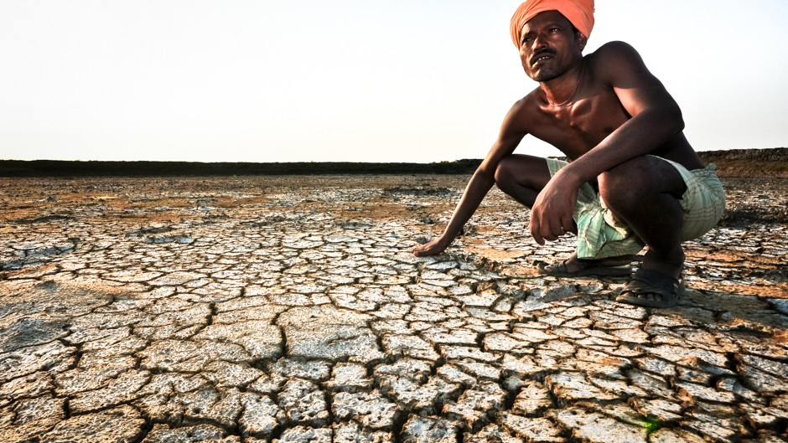
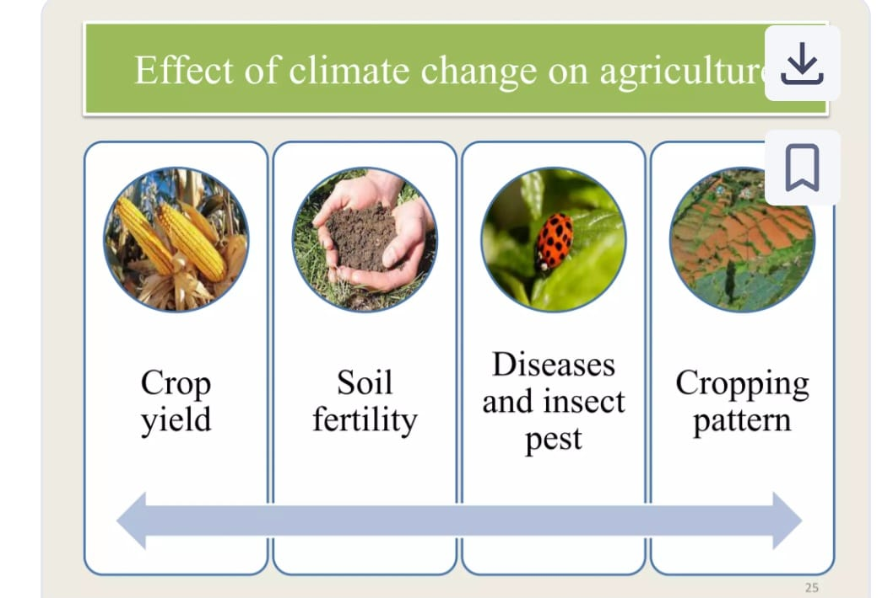
IMPACT OF CLIMATE CHANGE ON AGRICULTURE
Rise in temperature likely to affect crops differently from region to region.
India is a predominantly agriculture-oriented economy, As a 50 percent of the population directly depends on agriculture either as farmers or agriculture laborers
Food production in India is sensitive to climate change like variations in temperature and monsoon
It is predicted that a loss of 10 to 40 percent in production may occur by 2100 in India due to climate change

Slide 4
Temperature & Yield:
Crop yields show sensitivity to average temperatures; yields tend to drop when average temperatures rise above optimal ranges, especially in corn and wheat.
Extremely high temperatures correlate with reduced soil health and lower yields, particularly in regions with poor irrigation access.
Extreme Weather Events:
Regions with a higher frequency of extreme weather events (e.g., floods, droughts) report lower average crop yields and more significant economic losses.
Adaptation Strategies:
Common strategies include water management, crop rotation, and in many cases, no adaptation, which correlates with lower soil health and economic performance.
Inputs vs Outcomes:
Heavy pesticide and fertilizer use does not always translate to higher yields; without good soil health and weather stability, efficiency drops.
Soil Health Index is a strong predictor of sustainable yield outcomes.
Regional Differences:
Developed regions (e.g., France, Canada) often report higher irrigation access and better soil health.
Developing regions (e.g., parts of India and Africa) face greater climate stress with limited adaptation resources, amplifying negative impacts.
Economic Impact:
Economic losses are highest in regions experiencing both climate extremes and poor adaptive infrastructure.

Slide 5
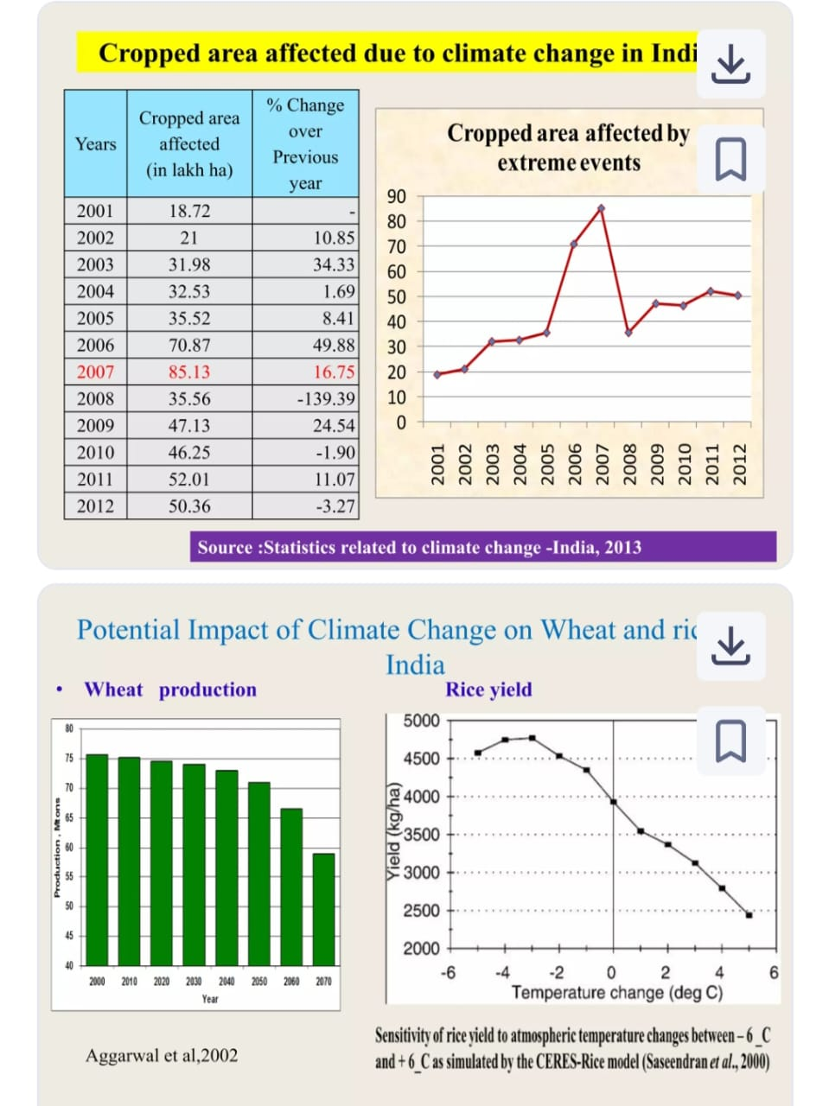
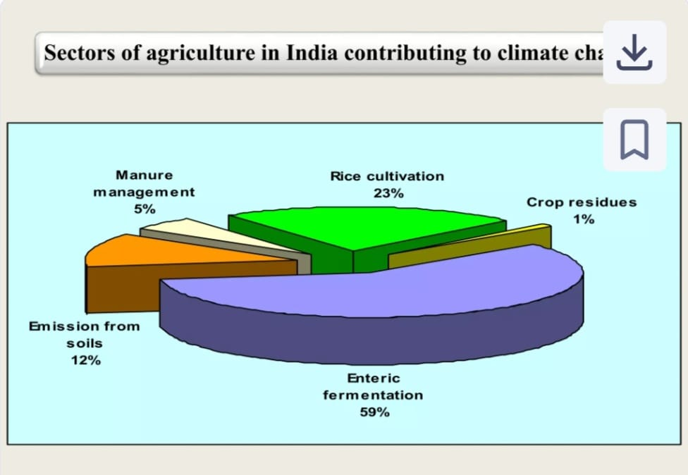
Adaptation Strategies:
Climate-resilient crops
Efficient irrigation systems
Sustainable land management
Technological innovation like precision agriculture
Mitigating these impacts requires coordinated global action, investment in research for farmers to transition toward climate-smart practices.

Slide 6
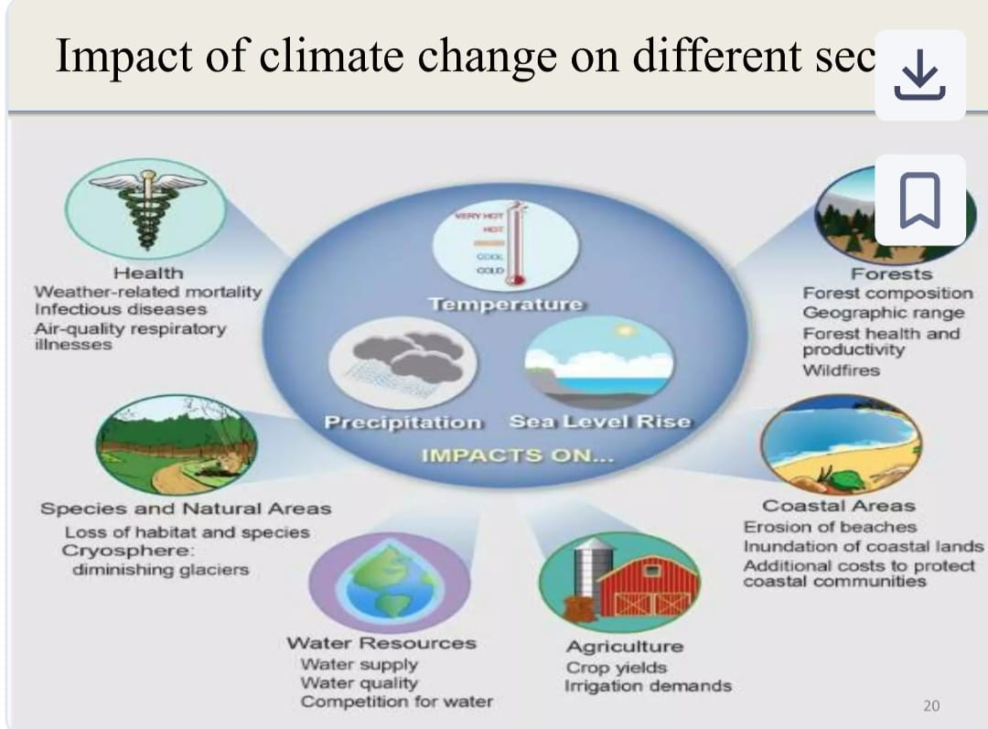
Overcome the challenges of climate change in agriculture
Water and Soil Management
Leverage Technology and Innovation
Strengthen Policy and Institutional Support.
Adopt Climate-Smart Agricultural Practices
Invest in Research and Education
Enhance Global and Regional Cooperation

Slide 7
Conclusion
Climate change poses a significant and growing threat to global agriculture. Rising temperatures, shifting rainfall patterns, extreme weather events, and increased pest and disease pressure disrupt crop yields and livestock productivity. These changes affect food security, especially in vulnerable regions with limited adaptive capacity. While some areas may benefit from longer growing seasons, the overall impact is negative—particularly in tropical and low-income regions. To sustain agricultural productivity, it is essential to adopt climate-resilient practices, improve resource management, and invest in research and technology to support adaptation and mitigation strategies.

Slide 8
